Slide 1
Introduction to Java Web Development
Key Concepts and Technologies for Modern and Scalable Web Applications

Slide 2
Overview
Java Web Development
Spring Framework
Frontend Integration
Build Automation Tools
CI/CD Jenkins and Git
Software Architecture
Docker Containers
Kubernetes

Slide 3
Java Web Development
Java is a versatile, platform independent programming language
Rich set of Libraries and Frameworks
Spring framework, Hibernate, unit testing libraries
Strong community around
Supports various architectures
Strong community support and constantly updated

Slide 4
Java Web Application Technologies
Spring Framework
A collection of projects for building scalable web applications
Most popular Java framework
JPA (Java Persistent API) and Hibernate
Database management and Interaction
Some other technologies that are used in industry are Java Servlet API, JSP, J2EE, JMS

Slide 5
Spring
Most popular Java Framework for building modern, scalable APIs with Modular architecture that allows developers to use only components they need
Some key features
Inversion of Control (IoC): Simplifies dependency management with annotations like @Autowired
Transaction Management: Manages database transactions seamlessly across different data sources
Spring MVC: Provides a powerful Model-View-Controller architecture for web applications
Spring Boot: Simplifies application setup and development. Auto config, embedded servers, dependency initialization

Slide 6
Spring
Advantages of Spring Framework
Modularity: No need to include every spring ‘project’ in your project, just what you need
Production Ready: Includes utilities to monitor, secure, metrics etc for your application
Ecosystem: Active community and support (a lot of third-party integration)

Slide 7
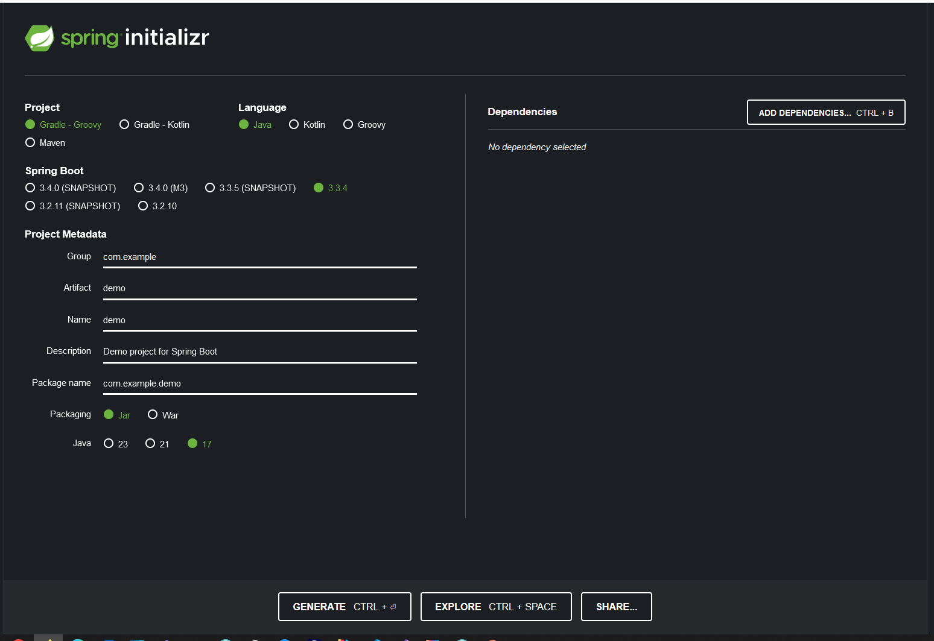
Spring
spring initializr

Slide 8
Frontend Integration
Java provides support for API driven architectures like SOAP, REST or GraphQL
Separation of concerns: Backend (business logic) separated from frontend (UI/UX)
Popular frontend technologies (React, Angular, Vue.js)
CORS (Cross-Origin Resource Sharing): Communication between frontend apps running on different domains and Java API’s
Spring Boot provides built-in support with annotations like @CrossOrigin

Slide 9
Build Automation And Dependency Management
Tools that streamlines project builds, dependency management and automation of tasks like testing, packaging, deployment and code compilation
Most popular tools are Maven and Gradle
Maven
XML based project configuration with a centralized file (pom.xml) that specifies dependencies, plugins, build lifecycle and more
Convention over Configuration: Developers are not required to create build process themselves. Tell me what you want, and I will do it with a standardized way
Build commands: mvn clean install, mvn package

Slide 10
Build Automation And Dependency Management
Gradle
Groovy/Kotlin-based Configuration: More flexible scripting approach with build.gradle or build.gradle.kts
Task-Based Model: Defines custom tasks easily, allowing greater control over the build process
Incremental builds: Don’t do the same thing over and over only whatever changes (Gradle Daemon)
Commands: gradle build, gradle clean etc

Slide 11
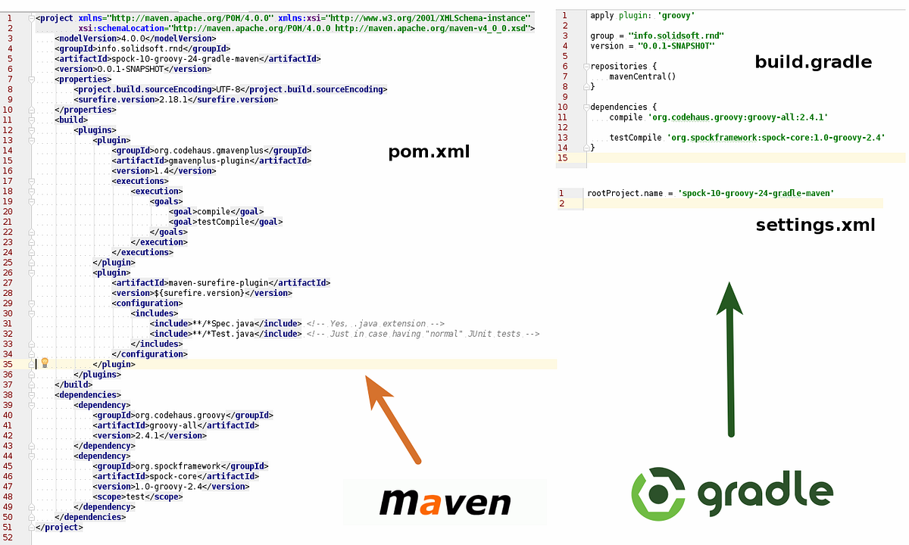
Build Automation And Dependency Management

Slide 12
CI/CD
Continuous Integration and Continuous Delivery(CI/CD), is the practice of automating integration of code from distributed teams into a single codebase.
Git is a free and open-source distributed version control system designed to handle everything from small to very large projects with speed and efficiency
Jenkins is a tool that is used for automation. It is mainly an open-source server that allows all the developers to build, test and deploy software. It is written in Java and runs on java only. By using Jenkins we can make a continuous integration of projects(jobs) or end-to-endpoint automation

Slide 13
Software Architecture
Monolithic: A single application that contains all components (UI, business logic, database)
Easy and cheap to develop in early stages but challenging to scale them as the requirements are increasing
N-tier Architecture (Layered): A traditional architecture where the application is divided into layers
Event-Driven Architectures: Components communicate through events, leading to decoupled services
Microservices: Architectural style where an application is divided into smaller independent services, each focusing on a specific business capabilities

Slide 14
Containerization with Docker
Docker is a platform that provides a way to package applications and their dependencies into lightweight, portable “Containers”
Isolation: Each microservice runs in its own container, ensuring that dependencies and configurations do not conflict with each other
Consistency: Docker ensures that the environment is the same across development, testing, and production
Microservice-friendly: Docker makes it easy to scale individual microservices up or down based on demand. You can run multiple instances of a service without worrying about resource conflicts
CI/CD Integration: Docker integrates well with CI/CD pipelines, enabling automated testing, deployment, and rollback of microservices

Slide 15
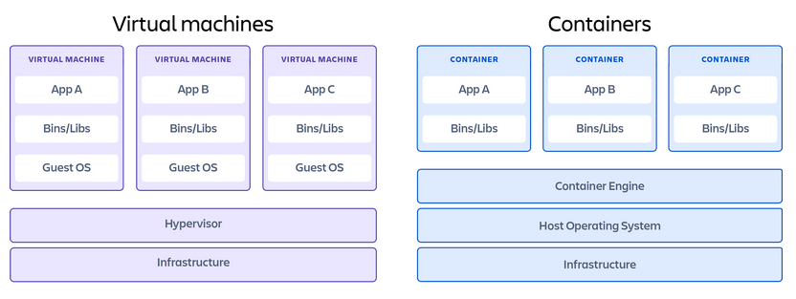
Containerization with Docker

Slide 16
Containerization with Docker
Image: Read-only template used to create Docker containers
Container: A running instance of a Docker image
Dockerfile: Script containing instruction on how to build a Docker Image
Registry: Registry, the open-source implementation for storing and distributing container images and other content. By default, the Docker engine interacts with DockerHub

Slide 17
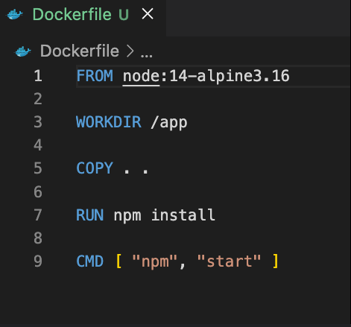
Containerization with Docker

Slide 18
Kubernetes
Kubernetes is an open-source platform that manages Docker containers in the form of a cluster. Along with the automated deployment and scaling of containers, it provides healing by automatically restarting failed containers and rescheduling them when their hosts die
Some benefits of K8s:
Automated deployment and management
Scalability
High Availability
Cost-effectiveness
Productivity boost

Slide 19
Kubernetes
Pod: Small deployable units that contain one or more containers
Service: Abstracts and exposes a set of pods as network service
Deployment: Manages the deployment and scaling pods
Node: A Node is a worker machine in Kubernetes and may be either a virtual or a physical machine, depending on the cluster
Cluster: A Kubernetes cluster is a set of nodes that run containerized applications

Slide 20
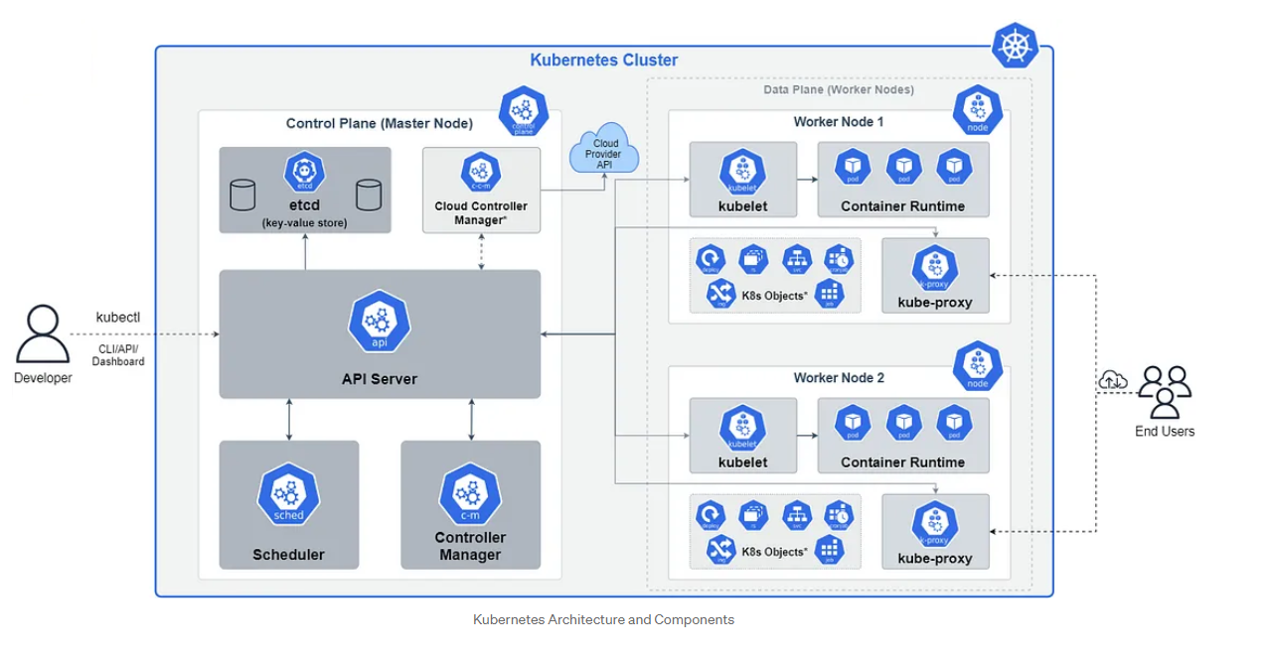
Kubernetes

Slide 21
References
Videos
Learn how to develop microservices with spring boot
Documentations
Docker
Spring
Gradle
Maven
Kubernetes
Jenkis
git

Slide 22
Q&A

